Slide 1
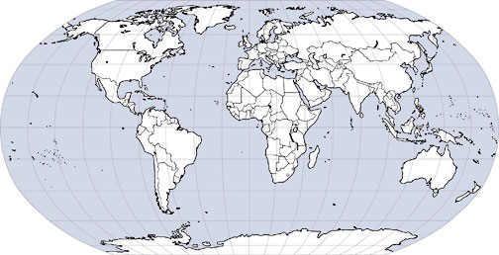
World’s Economic Center of Gravity
1950
2000
1900
1800
1500
2025
1000

